Slide 1
Recommender System
Wenxin Xu
August 4, 2021
Notes:
Hi, I’m Wenxin, today I’m going to talk about recommender systems

Slide 2
Content
Overview
Types of Rec Systems
Rec Tasks
Feedback
Pairwise Ranking Loss
Models
Matrix Factorization (MF)
AutoRec
NeuMF
Caser
Factorization Machine (FM)
DeepFM
Notebook
Dataset
Evaluation
Summary
Notes:
first, I’m going to introduce some basic concepts of rec systems, their types and tasks
then, i will talk about some classical and advanced DL based rec system models
at last, we will go to the notebook

Slide 3
Content
Overview
Types of Rec Systems
Rec Tasks
Feedback
Pairwise Ranking Loss
Models
Matrix Factorization (MF)
AutoRec
NeuMF
Caser
Factorization Machine (FM)
DeepFM
Notebook
Dataset
Evaluation
Summary

Slide 4
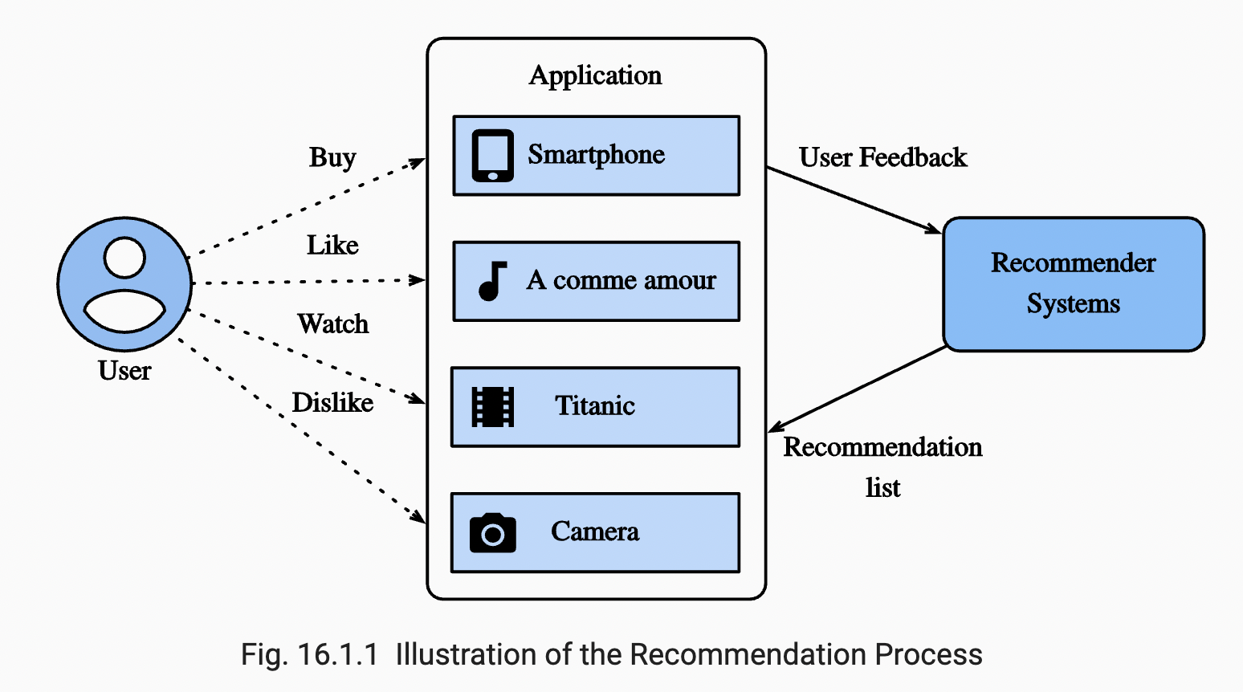
Overview: Recommender Systems
Notes:
def of recommender system
is very common in real-world, such as online shopping sites (e.g. Amazon), movie sites (e.g. Netflix), video sites e.g. Youtube, music sites (e.g., Spotify), mobile app stores (e.g., Google Play), online advertising
it can be viewed as an info filtering tool
learn from abundant features of data to recommend items to users, items can be movies, news, books and other products
people use it coz it can
help company make profits and improve user experience
help users discover interested items that they never searched for, e.g. movies to watch, books to read, products to buy
like a replacement of search engines,
reduce effort in finding items
reduce issue of info overload

Slide 5
Content
Overview
Types of Rec Systems
Rec Tasks
Feedback
Pairwise Ranking Loss
Models
Matrix Factorization (MF)
AutoRec
NeuMF
Caser
Factorization Machine (FM)
DeepFM
Notebook
Dataset
Evaluation
Summary
Notes:
there are 3 types of rec systems

Slide 6
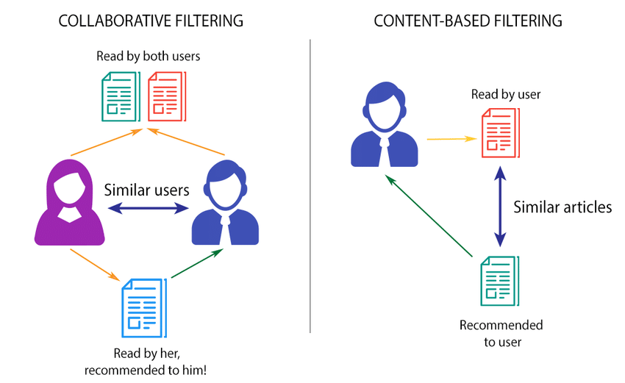

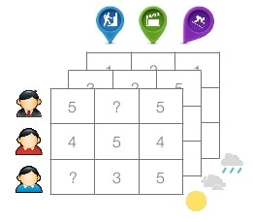
Types of Rec Systems
CONTEXT-BASED FILTERING
CF-based: user-item interaction, e.g. like/dislike, click or not
Content-based: item features, user profiles
Context-based: timestamp, location, weather
Notes:
3 types of rec systems: CF-based, content-based, context-based
collaborative filtering (CF)
CF means collaborative filtering, is a key concept in recommendation
making automatic predictions (filtering) about the interests of a user by collecting preferences from many users (collaborating)
e.g. if user A and B have similar features, they’re both interested in science fiction movies, CF-based Rec system may recommend B a movie that A has watched but B hasn’t
CF only use user-item interaction data as input, e.g. if the user likes or dislikes an item, clicked or not clicked an ad
the second type, Content-based recommenders
treat recommendation task as a user-specific classification problem
learn a classifier for the user's likes and dislikes based on an item's features.
e.g. if a user is interested in science fiction movies and has watched a movie A, the content-based rec system may recommend another similar scientific movie B to the user
the third type, Context-based recommender:
utilize contextual info, such as timestamp, location, weather

Slide 7
Content
Overview
Types of Rec Systems
Rec Tasks
Feedback
Pairwise Ranking Loss
Models
Matrix Factorization (MF)
AutoRec
NeuMF
Caser
Factorization Machine (FM)
DeepFM
Notebook
Dataset
Evaluation
Summary
Notes:
based on types of feedback and input data: we have different kinds of rec tasks

Slide 8
Recommendation Tasks
Based on application domain
Movies Rec
News Rec
Point-of-interest Rec
Based on feedback and input data
Rating prediction (explicit feedback)
Top-n rec/Personalized ranking (implicit feedback)
Sequence-aware rec (timestamp input)
Click-through rate prediction
(implicit feedback with various categorical features)
Notes:
point of interest (POI) recommendation aims to recommend unvisited places to users based on their check-in history.
Rating prediction: takes explicit feedback as input, predict ratings that a user might give to an item
top-n rec or personalized ranking: takes implicit feedback as input, predict the order of a list of items that a user might give to the list.
Sequence-aware rec: takes timestamp as input, predict the next item that a user might want to buy based on a time-ordered list of past user actions
Click-through rate prediction: takes implicit feedback with various categorical features as input, predict whether an ad/item will be clicked or not by a user

Slide 9
Content
Overview
Types of Rec Systems
Rec Tasks
Feedback
Pairwise Ranking Loss
Models
Matrix Factorization (MF)
AutoRec
NeuMF
Caser
Factorization Machine (FM)
DeepFM
Notebook
Dataset
Evaluation
Summary

Slide 10
Feedback
Types of feedback
Explicit
E.g., IMDB star ratings (1 -10 ⭐️), YouTube 👍🏻 & 👎🏻
Issues: hard to collect
Implicit
More common
User behaviors
E.g.. Click, purchase history, browsing history, watches and mouse movements
Issues: noisy
Notes:
so we have 2 types of feedbacks, implicit and explicit
feedback: collected from users in order to learn their preference
explicit feedback
e.g. IMDB collects star ratings (1-10 ☆) of movies, YouTube collects thumb up and down of videos
but explicit feedbacks are not always available
in contrast, implicit feedbacks, namely user behaviors
e.g., user click, purchase history, browsing history, watches and mouse movements are more common
but they also have issues, they are inherently noisy,
we can only guess user preferences and motives,
a user watched a movie may not like the movie
non-observed user-item pair = real negative feedback + missing values
real negative feedback: users aren't interested in these items
missing values: users may interact with these items in the future

Slide 11
Content
Overview
Types of Rec Systems
Rec Tasks
Feedback
Pairwise Ranking Loss
Models
Matrix Factorization (MF)
AutoRec
NeuMF
Caser
Factorization Machine (FM)
DeepFM
Notebook
Dataset
Evaluation
Summary
Notes:
finally, I want to introduce loss for personalized ranking tasks

Slide 12
Ranking Loss
Types of ranking loss
Pointwise
Mean Squared Error
Models: MF, AutoRec
Pairwise
Bayesian personalized ranking loss
Hinge loss
Models: NeuMF, Caser
Listwise
NDCG (normalized discounted cumulative gain)
Notes:
there are 3 types of ranking loss: pointwise, pairwise, listwise
pointwise: consider a single item-user interaction at a time and train a classifier or a regressor to predict individual preference
pairwise: consider a pair of items for each user and aim to approximate optimal ordering for that pair
listwise: consider an entire list of items for each user and aim to approximate optimal ordering of that list
today we only focus on pairwise ranking loss:
it's more suitable for ranking task coz predicting relative order is close to nature of ranking
Bayesian and Hinge loss can be used interchangeably

Slide 13
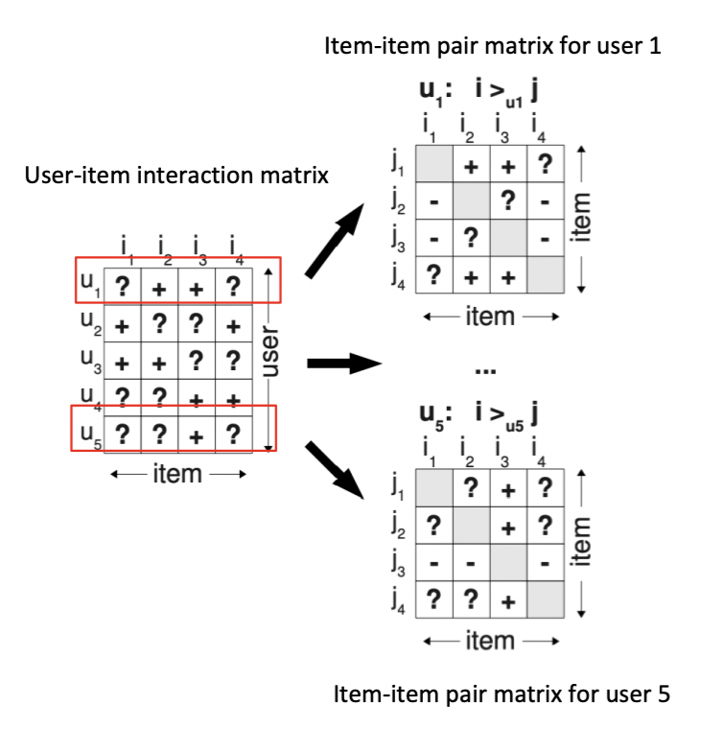
Pairwise Ranking Loss
Training data: positive (liked) and negative pairs (disliked + missing values)
Assumption: user prefers positive item over all other negative items
For each user, construct a n x n item-item pair matrix, where n is number of items
Notes:
training set has both positive and negative item pairs
and we assume user u prefers positive item I over negative item j
for each user 𝑢, we construct an 𝑛 by n item-item pair matrix
where 𝑛 is number of items

Slide 14
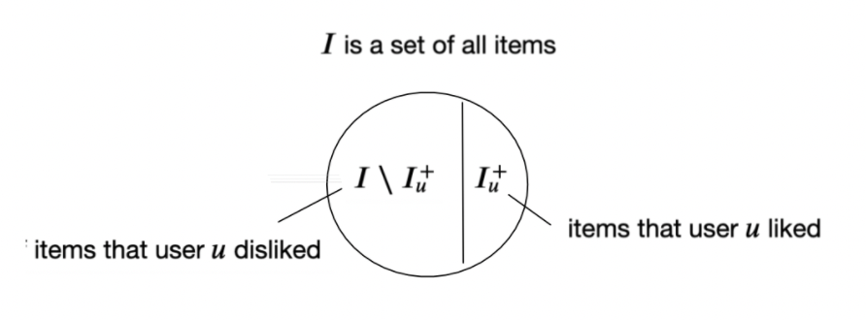
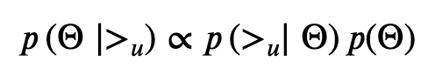
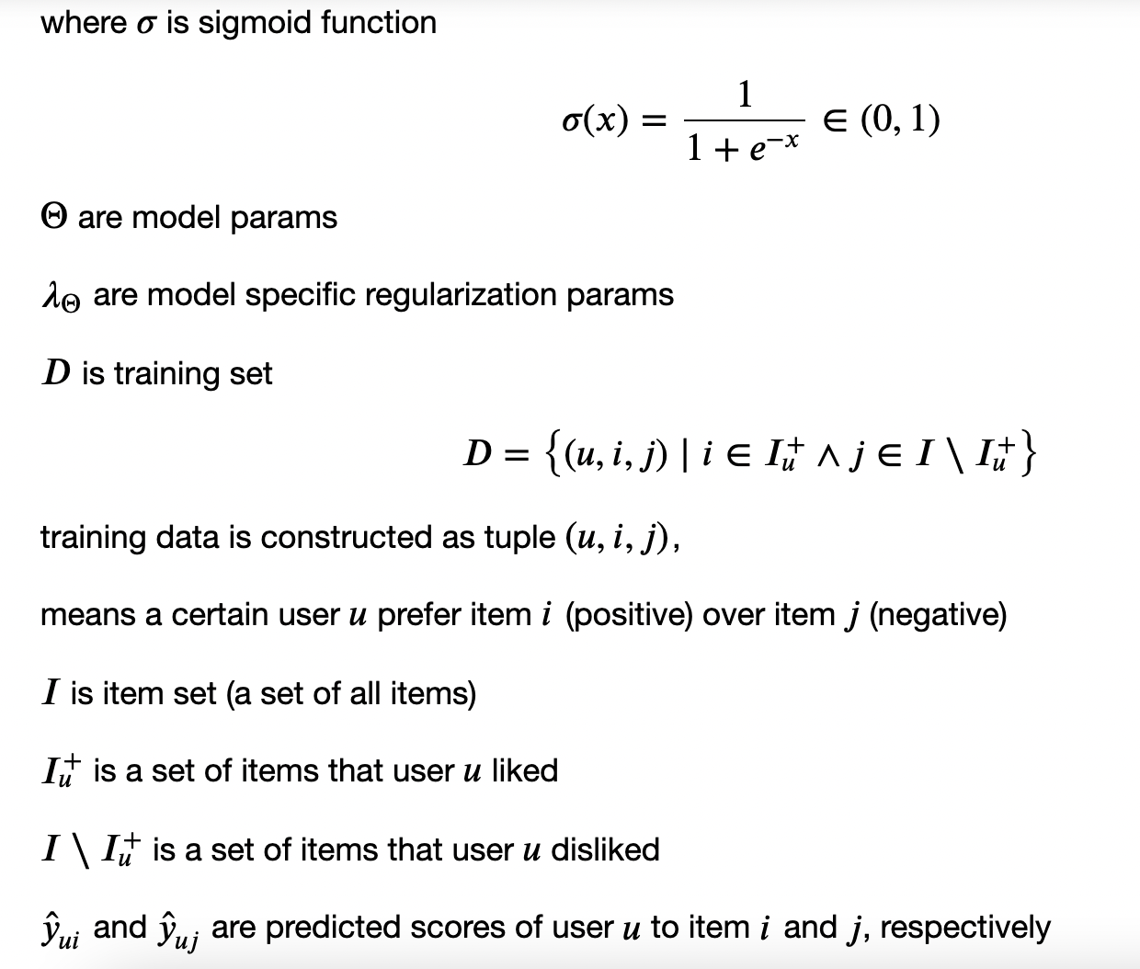
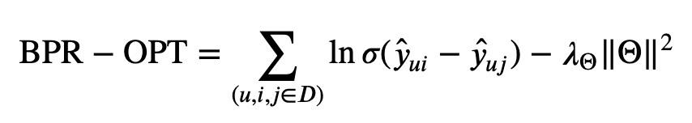
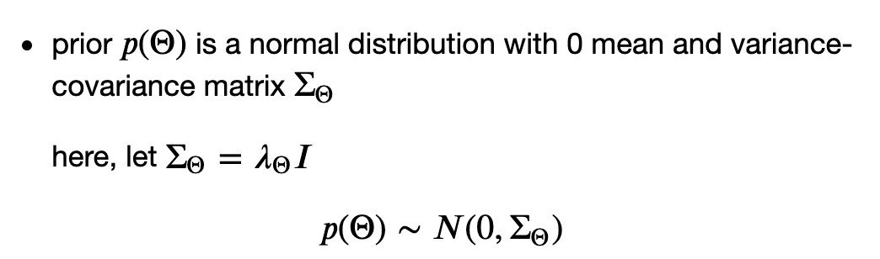
Bayesian personalized ranking loss (BPR)
Rendle, 2019: BPR: Bayesian Personalized Ranking from Implicit Feedback
Derivation: maximize posterior estimator
Definition:
Notes:
Bayesian personalized ranking loss is derived from maximum posterior estimator
𝐷 is training set
each training sample is constructed as a tuple (𝑢,𝑖,𝑗) hat y ui and hat y uj are predicted scores of user 𝑢 give to item 𝑖 and 𝑗, respectively
prior 𝑝(Θ) is a normal distribution with 0 mean and variance-covariance matrix ΣΘ
𝜎 is sigmoid function
Θ are model params
𝜆Θ are model specific regularization params

Slide 15
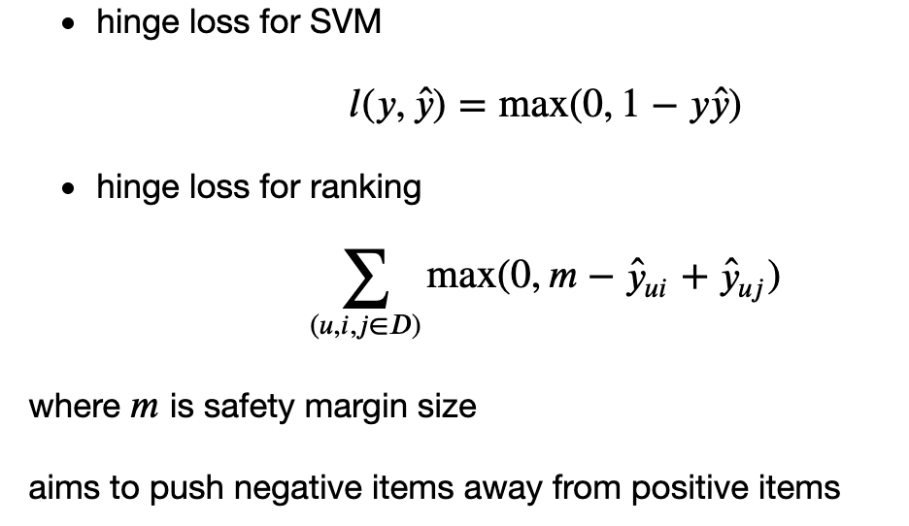
Hinge loss
Notes:
another loss can be used for personalized ranking task is Hinge loss
hinge loss for ranking is different from that for support vector machine
where loss is the largest value of 0 or 1 – y multiply hat y
similar to Bayesian loss, hinge loss aims to optimize for relevant distance between positive and negative samples instead of absolute outputs,
make it very suited to rec systems

Slide 16
Content
Overview
Types of Rec Systems
Rec Tasks
Feedback
Pairwise Ranking Loss
Models
Matrix Factorization (MF)
AutoRec
NeuMF
Caser
Factorization Machine (FM)
DeepFM
Notebook
Dataset
Evaluation
Summary
Notes:
then, i will talk about some classical and advanced DL based models
our first model is matrix factorization

Slide 17
Content
Overview
Types of Rec Systems
Rec Tasks
Feedback
Pairwise Ranking Loss
Models
Matrix Factorization (MF)
AutoRec
NeuMF
Caser
Factorization Machine (FM)
DeepFM
Notebook
Dataset
Evaluation
Summary

Slide 18
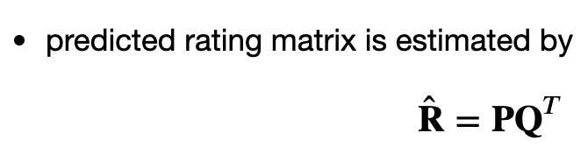
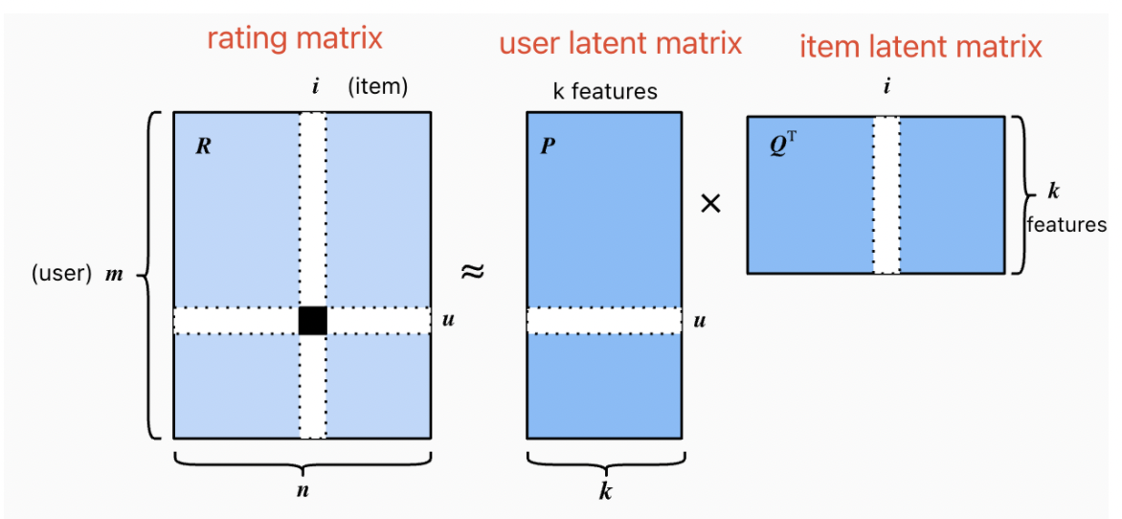
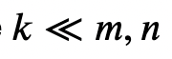
Matrix Factorization (MF)
2016 Netflix Contest winner
Used for rating prediction tasks
Idea: capturing low-rank (k) structure of user-item interactions
Notes:
matrix factorization
is a class of collaborative filtering models
used to predict ratings that a user might give to an item
a winner of 2016 Netflix contest
idea
factorize a user-item interaction matrix R (rating matrix, values of 𝐑 are explicit ratings) into product of 2 lower-rank matrices, a user latent matrix 𝐏 and an item latent matrix 𝐐
predicted rating matrix hat R is estimated by matrix product of P and Q transpose
user latent matrix P: for a given user 𝑢, elements of 𝐩𝑢 measure extent of interest the user has in items' 𝑘 features, e.g. genres and language of a movie
item latent matrix Q: for a given item 𝑖, elements of 𝐪𝑖 measure the extent to which the item possesses those 𝑘k features, e.g. genres and language of a movie

Slide 19

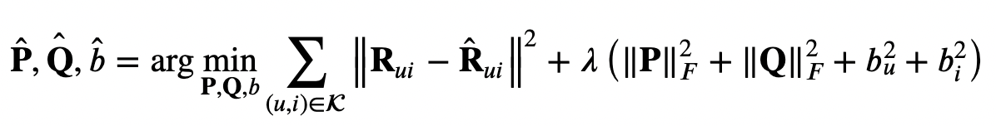
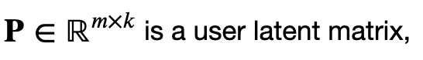
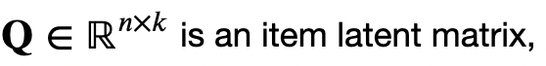


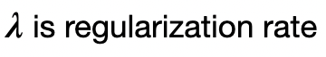
Matrix Factorization (MF)
Notes:
training goal
find optimal params 𝐏,𝐐,𝑏ias by minimizing objective function using optimization algorithm (e.g. SGD, Adam)
objective function
is reconstruction error between predicted rating scores hat 𝐑 and real rating scores 𝐑 with regularization

Slide 20

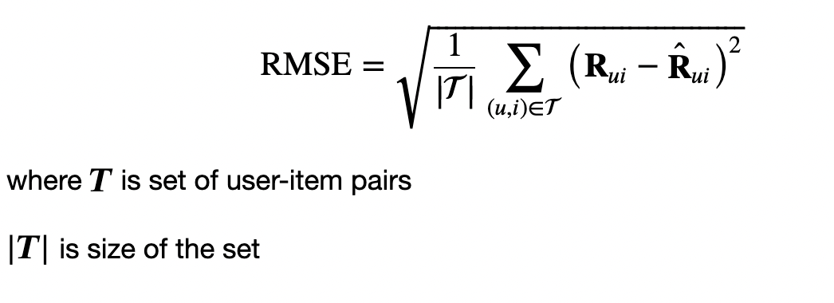
MF: Evaluation Metric
Notes:
we use root-mean-square-error as evaluation metric,
measure difference between predicted ratings and true ratings

Slide 21
Content
Overview
Types of Rec Systems
Rec Tasks
Feedback
Pairwise Ranking Loss
Models
Matrix Factorization (MF)
AutoRec
NeuMF
Caser
Factorization Machine (FM)
DeepFM
Notebook
Dataset
Evaluation
Summary
Notes:
dis of MF
though matrix factorization model have decent performance on rating prediction task,
it's a linear model
so it can't capture complex nonlinear relationships that maybe predictive of users' preferences
so we integrate nonlinear autoencoder into MF, create AutoRec model

Slide 22
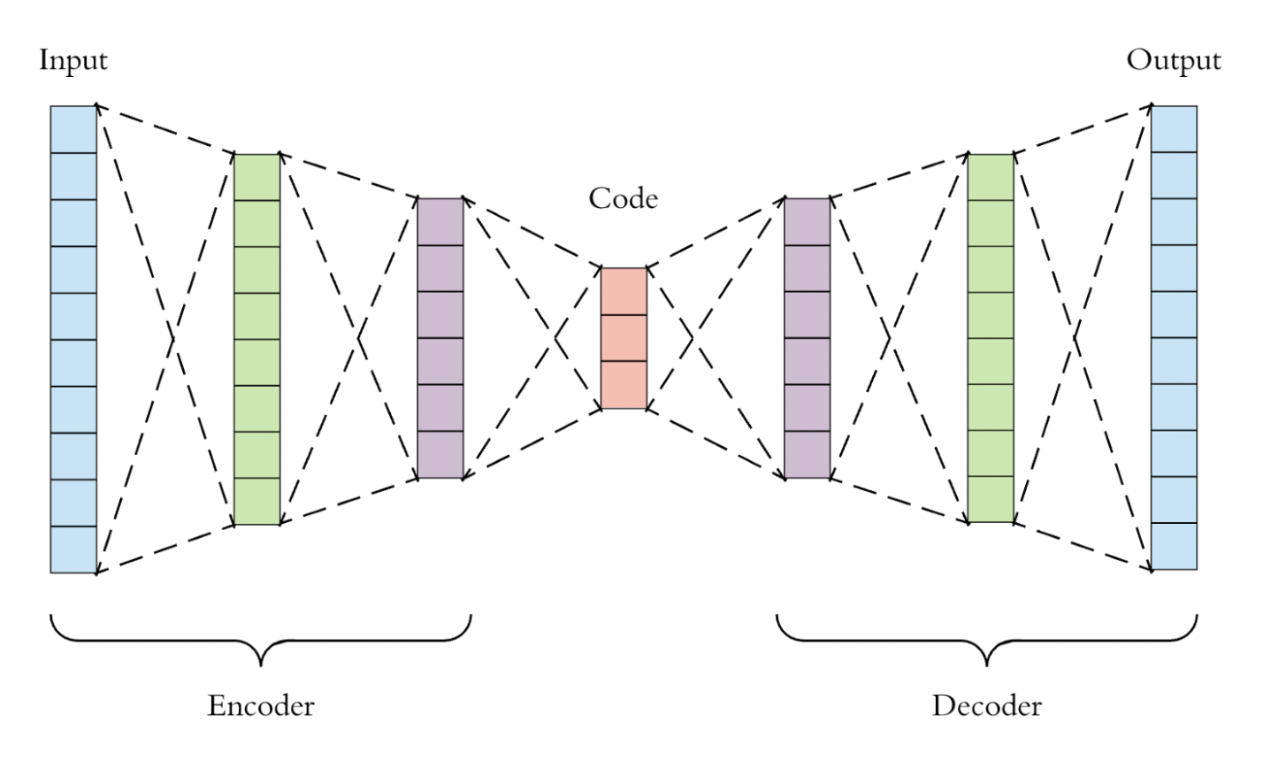
AutoRec: framing MF with Autoencoders
2015
Used for rating prediction tasks
A nonlinear neural net CF model
AutoRec VS. Autoencoder
Same structure
Difference:
AutoRec: learns/reconstructs
output layer
Autoencoder: learns hidden representations
Variants of AutoRec: user-based, item-based
Notes:
so we integrate nonlinear autoencoder into MF, create AutoRec model
instead of explicitly embedding users/items into low-dimensional space
it uses column/row of interaction matrix as input,
then reconstructs interaction matrix in output layer
the missing entries of input are filled in output for purpose of rec
an autoencoder: a NN that learns to copy its input to its output in order to code the inputs into hidden representations (usually very low-dimensional)
AutoRec has 2 variants: user-based, item-based
here we only focus on item-based AutoRec

Slide 23
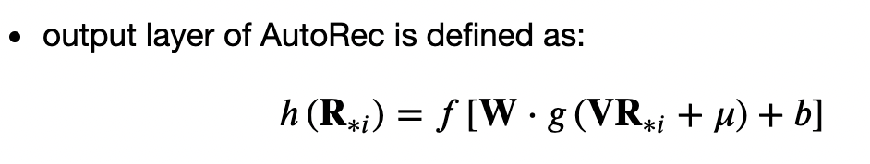
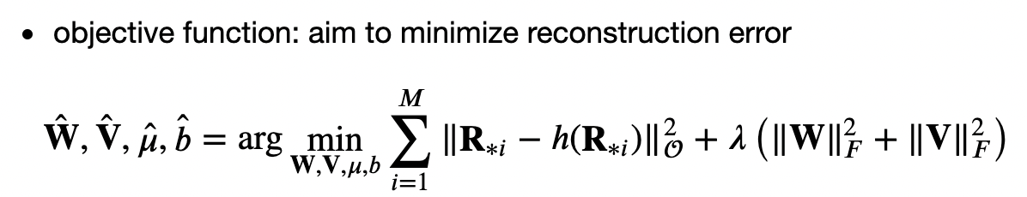

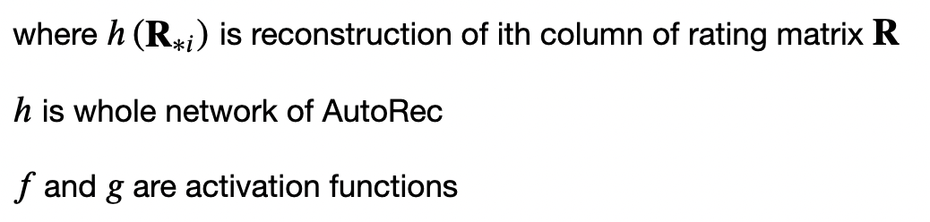
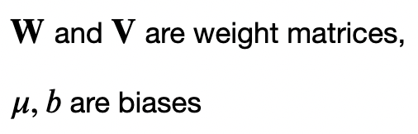

AutoRec: framing MF with Autoencoders
Notes:
the output layer is defined as below
ℎ is whole network of AutoRec,
ℎ(𝐑∗𝑖) is reconstruction of ith column of rating matrix 𝐑
𝑓 and 𝑔 are activation functions
𝐖 and 𝐕 are weight matrices,
𝜇,𝑏 are biases
objective function is aimed to minimize reconstruction error
we use same evaluation metric, root-mean-square-error

Slide 24
Content
Overview
Types of Rec Systems
Rec Tasks
Feedback
Pairwise Ranking Loss
Models
Matrix Factorization (MF)
AutoRec
NeuMF
Caser
Factorization Machine (FM)
DeepFM
Notebook
Dataset
Evaluation
Summary
Notes:
MF and AutoRec only take explicit feedback as input, predict ratings that a user might give to an item
as we said before, implicit feedback such as clicks, purchase and watch are easier than explicit feedback to collect and indicative of user preferences
NeuMF takes implicit feedback as input, used for personalized ranking tasks

Slide 25
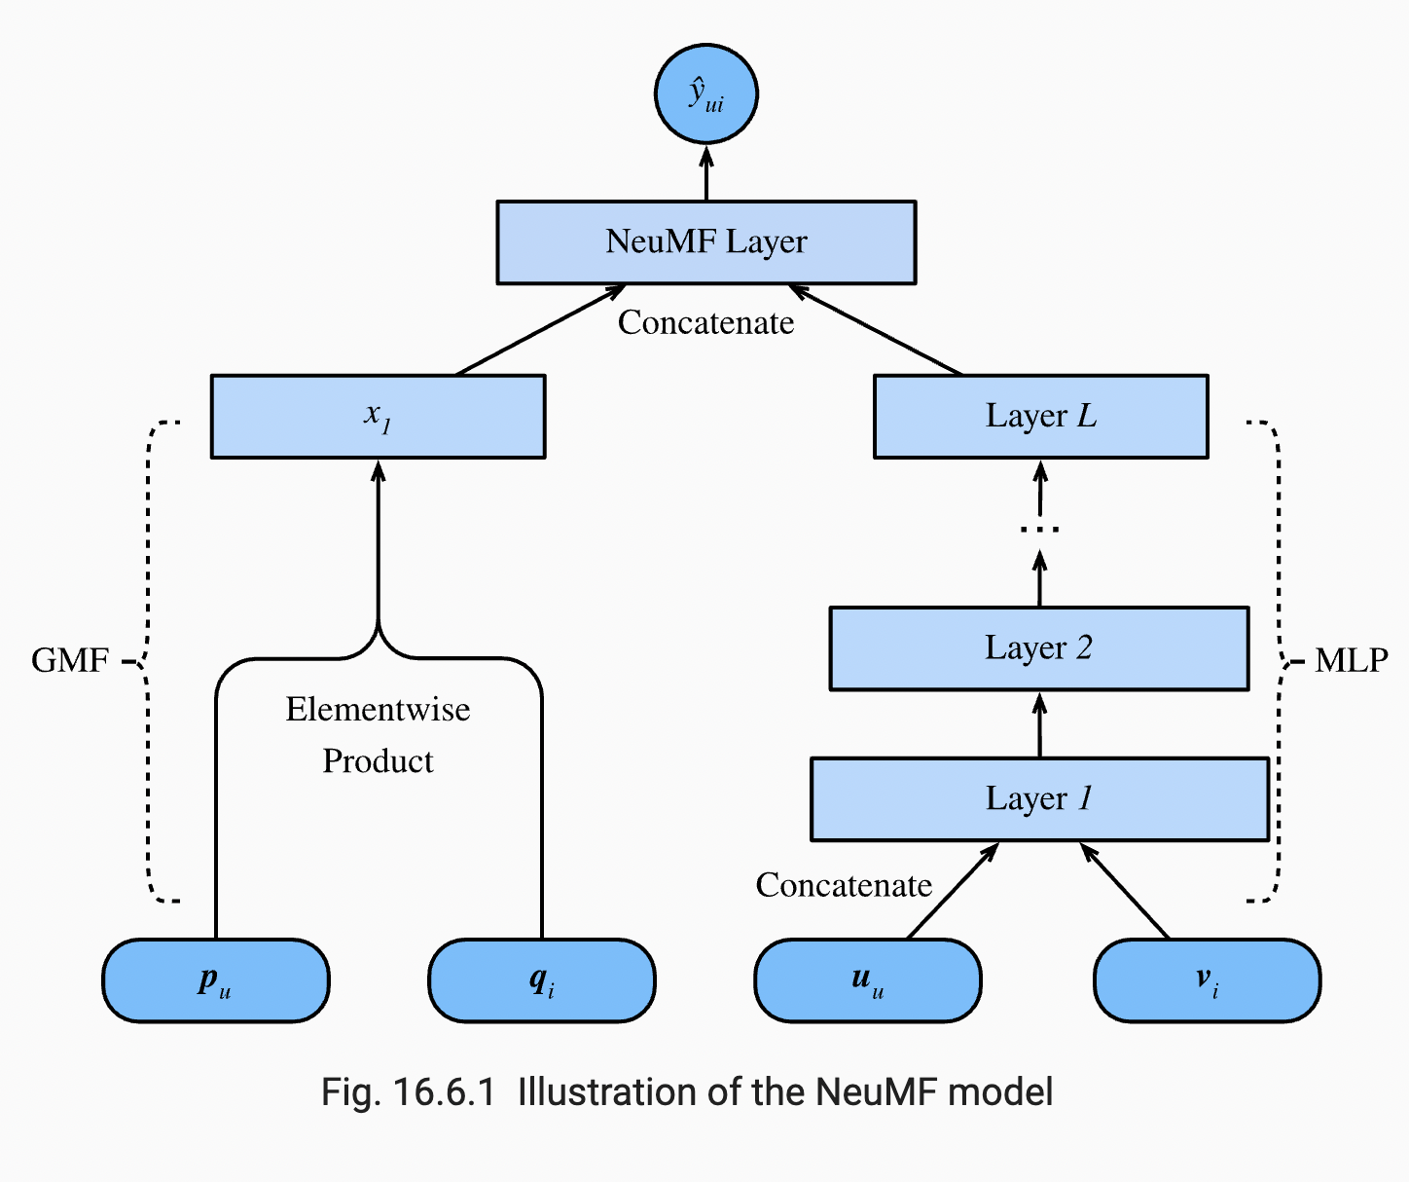
NeuMF: Neural Matrix Factorization
2017
Used for personalized ranking task with implicit feedback
A combination of MF and MLP to capture nonlinearity
Architecture
Part 1: 2 subnets GMF + MLP
Part 2: 1 NeuMF layer
Loss: personalized ranking loss
BPR loss or Hinge loss
Notes:
Neural matrix factorization is used for personalized ranking task with implicit feedback
idea is that adding nonlinearity to matrix factorization model can improve model capability and effectiveness
model architecture
the model consists of 2 subnets: a generalized matrix factorization (GMF) subnet and a multilayer perceptron (MLP) subnet
models 2 pathways instead of simple inner products
then the outputs of these 2 networks are concatenated for final scores calculation
serves as input of the final NeuMF layer
generate a ranked rec list to each user
loss function is personalized ranking loss

Slide 26
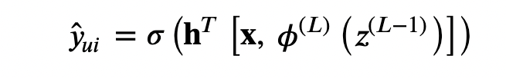
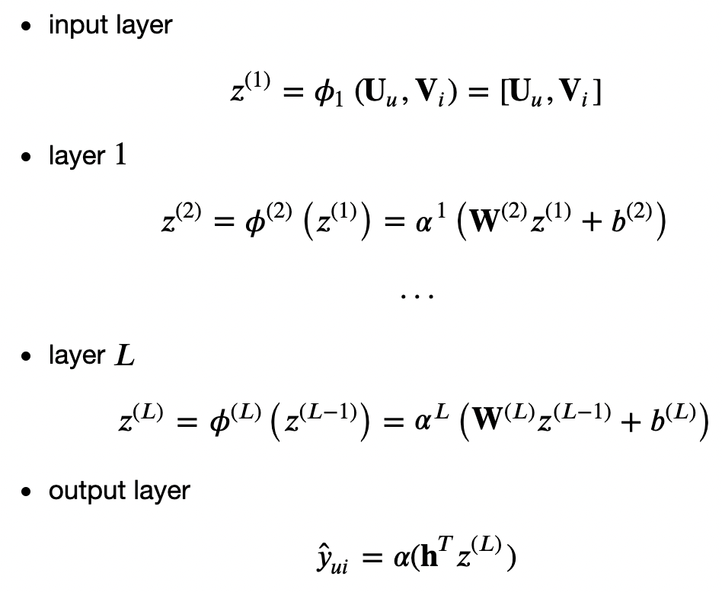
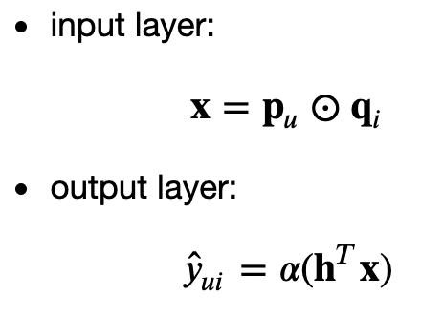
NeuMF: Model Architecture
MLP
GMF
Notes:
here are the details of model architecture
GMF has 2 neural layers
input is elementwise product of user and item latent factors p and q
MLP has 𝐿+2 layers
to enrich model flexibility, it uses different user and item embeddings from GMF, U and V
input is concatenation of user and item embeddings U and V with complex connections and nonlinear transformations
it can estimate complex interactions between users and items
the final prediction layer: NeuMF layer
merge results of GMF and MLP
by concatenating 2 outputs of 2nd last layers of 2 subnets as input, that is x and 𝜙(𝐿)(𝑧(𝐿−1))

Slide 27
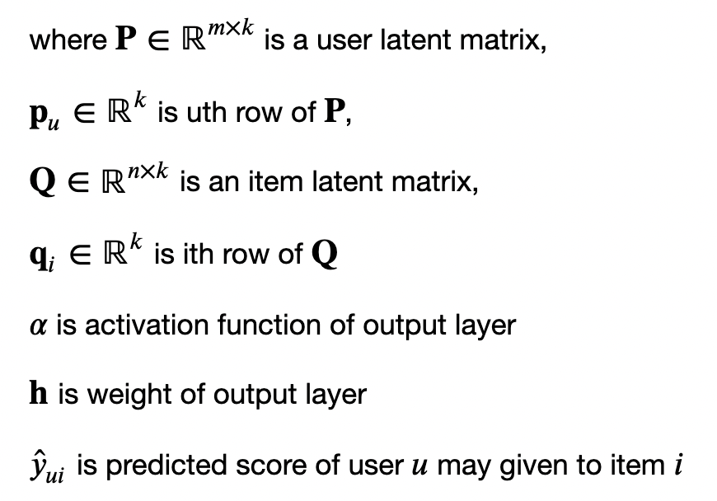
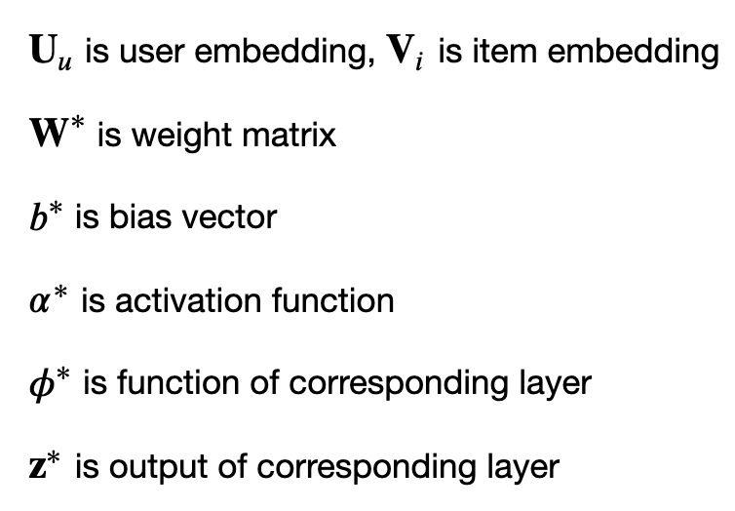
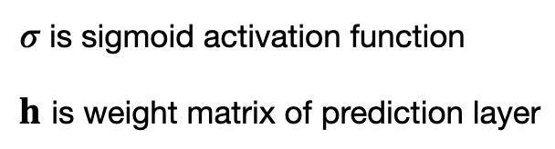
NeuMF: Notations

Slide 28
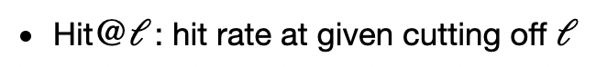
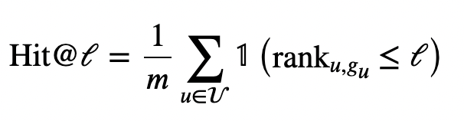
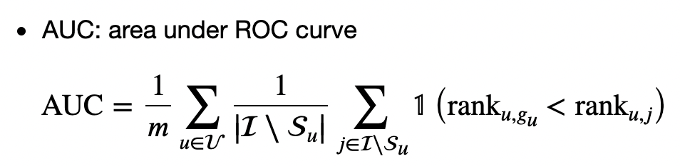
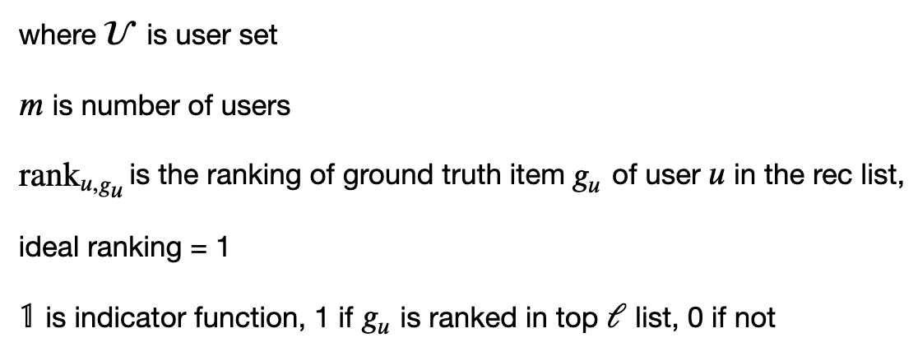
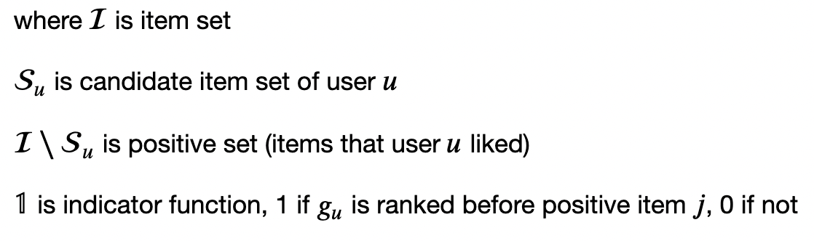
NeuMF: Evaluation Metrics
Notes:
in the Notebook, we use 2 evaluation metric: Hit@ℓ, AUC
we can also use other evaluation metric,
e.g. precision, recall, normalized discounted cumulative gain (NDCG)
Hit@ℓ is hit rate at given cutting off ℓ
indicates for each user, whether the recommended item is included in the top ℓ ranked list
rank𝑢,𝑔𝑢 is the ranking of ground truth item 𝑔𝑢 of user 𝑢 in the rec list, ideal ranking is 1
AUC is area under ROC curve
indicator function is 1 if ground truth item 𝑔𝑢 is ranked before positive item 𝑗, 0 if not

Slide 29
Content
Overview
Types of Rec Systems
Rec Tasks
Feedback
Pairwise Ranking Loss
Models
Matrix Factorization (MF)
AutoRec
NeuMF
Caser
Factorization Machine (FM)
DeepFM
Notebook
Dataset
Evaluation
Summary
Notes:
previously, we view rec task as a matrix completion problem
that is, fill the missing entries in an incomplete matrix
without considering users' short-term behaviors
the seq-aware recommender systems, such as Caser, consider both short-term and long-term behaviors

Slide 30
Caser: convolutional sequence embedding rec model
2018
Sequence-aware rec system
Goal: rec items based on user short-term and long-term interests
short-term interest: capture by CNN
long-term interest: capture by FC layer
Architecture: 2 parallel CNNs, a FC layer
a horizontal CNN: captured union-level seq patterns
a vertical CNN: captured point-level seq patterns
a FC layer: captures general interests (long term)
Loss: BPR loss or Hinge loss
Notes:
seq-aware recommender
it starts from 2018
idea: is that infer a user's short-term and long-term interests can make prediction of next item that he preferred more effectively
input: an ordered and often timestamped list of past user actions
Caser is convolutional sequence embedding recommendation model
conv NN can be used to capture user's short-term interests from sequential interactions
long term interest is captured by fully connected layer as usual
model architecture
Caser has 2 parallel CNNs followed by a FC layer
a horizontal CNN: captures union-level seq patterns
a vertical CNN: captures point-level seq patterns
union-level seq patterns: impact of several previous actions on subsequent target item
point-level seq patterns: impact of single item in historical seq on target item
e.g. a user has a higher probability to buy flour
if he bought milk and butter together before,
than he just bought one of milk or butter
we also use BPR loss or Hinge loss

Slide 31
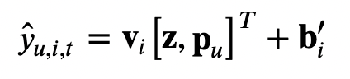
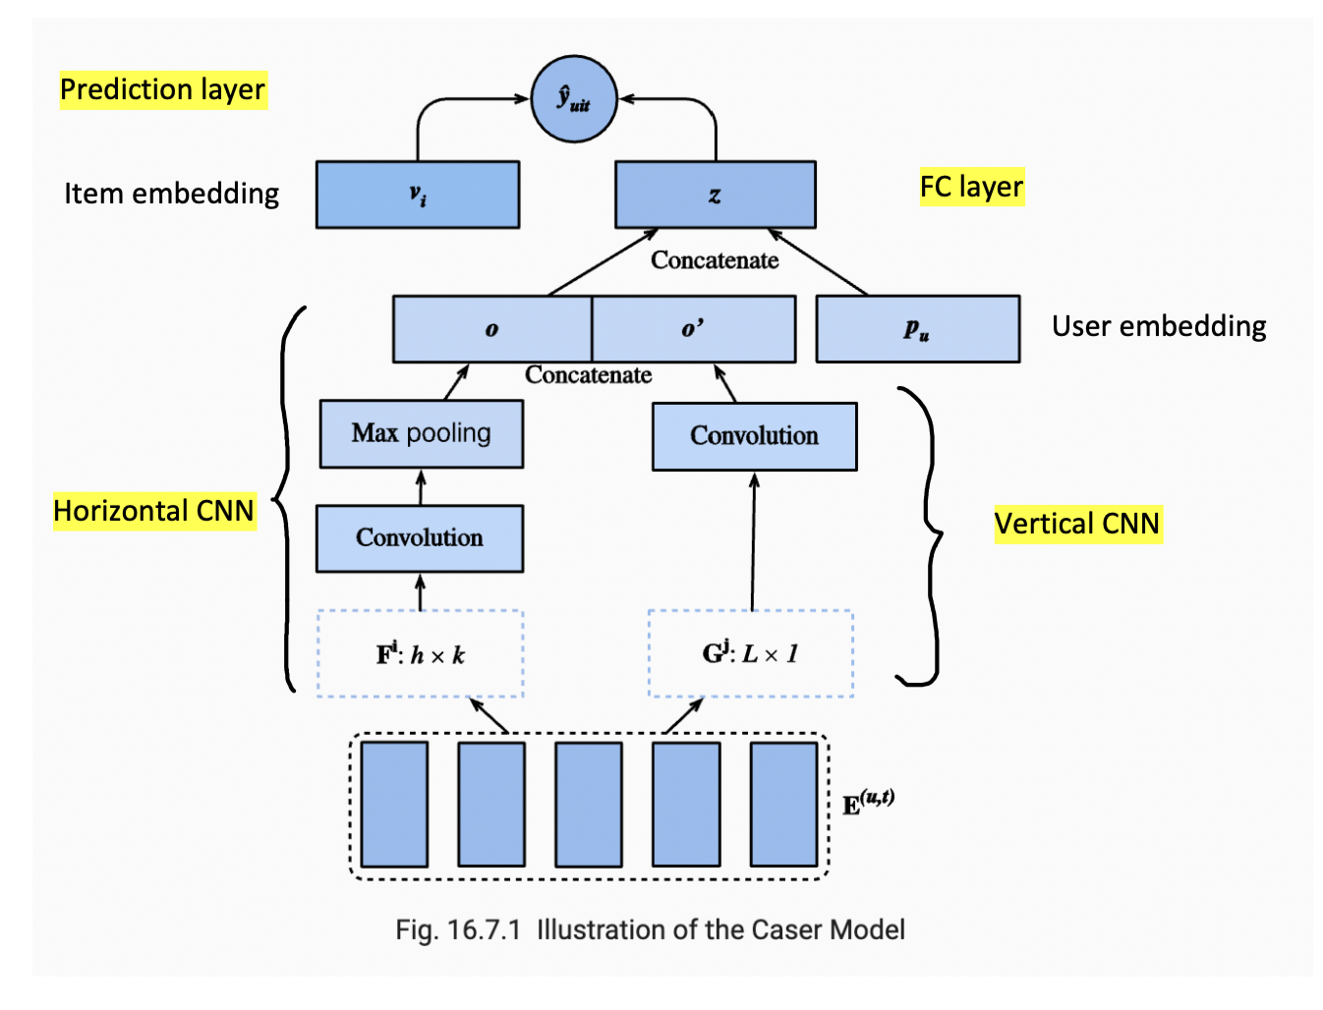
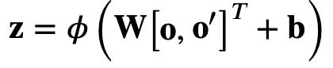
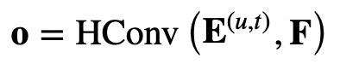
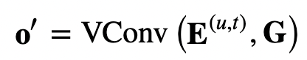
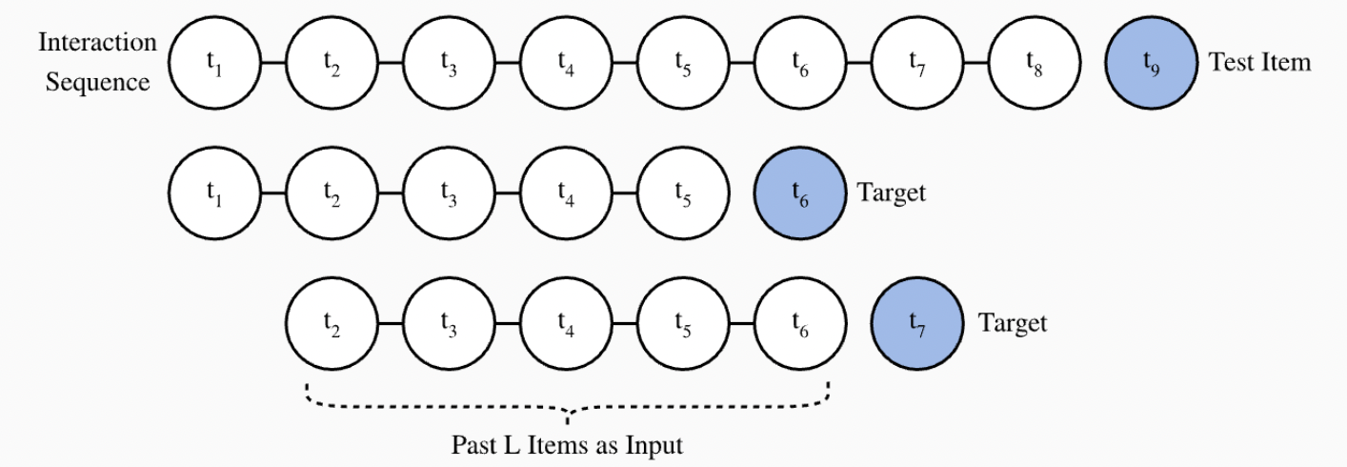
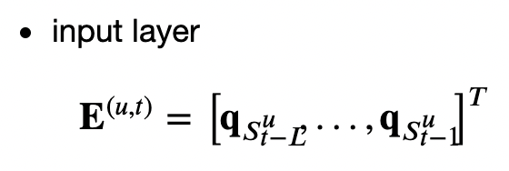
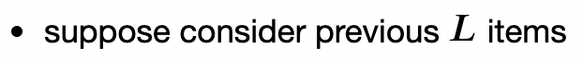
Caser: Model Architecture
Notes:
here are details of model architecture
suppose we consider previous L items
input layer
each sample containing a sequence of five (𝐿=5) movies and its subsequent item as the target item.
𝐄 is an embedding matrix represents former interactions of user 𝑢 with previous 𝐿 items for time step 𝑡,that is, short-term interest of user 𝑢 at time-step 𝑡
lowercase q is row of item embedding matrix Q
CNN
for simplicity, we omit details of a series of conv and pool operations in the following 2 CNN
this is output of horizontal conv layer, F are d horizontal filters
that is output of vertical conv layer, G are d’vertical filters
then the fully-connected layer
takes concatenation of 2 CNNs‘ outputs as input
output z, learned from short-term interest
finally, the prediction layer combines short-term and long-term interest together
input is concatenation of FC layer‘s output z and a user embedding of long-term interest 𝐩𝑢
output hat y is predicted score of user 𝑢 may given to item 𝑖 at time step 𝑡 , learned from both short-term and long-term interest

Slide 32
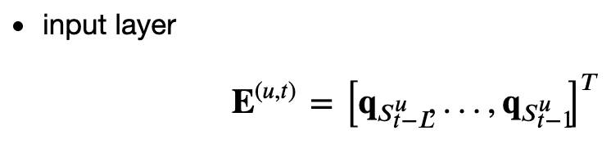
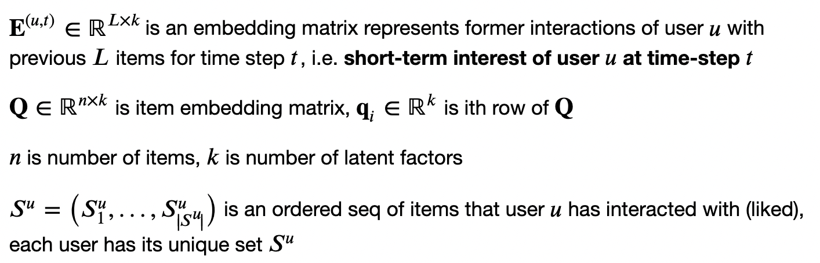
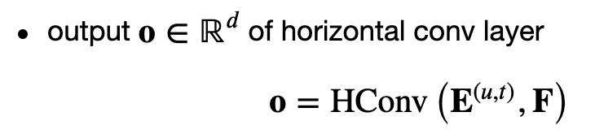
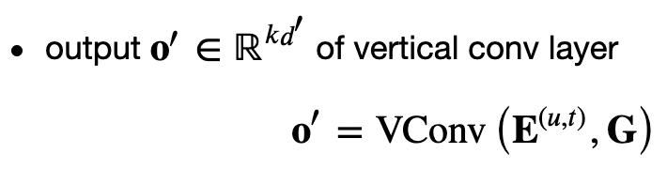

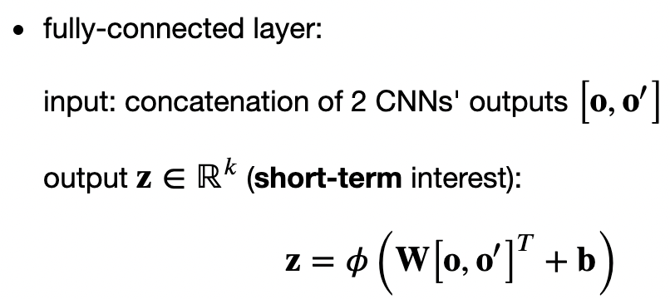


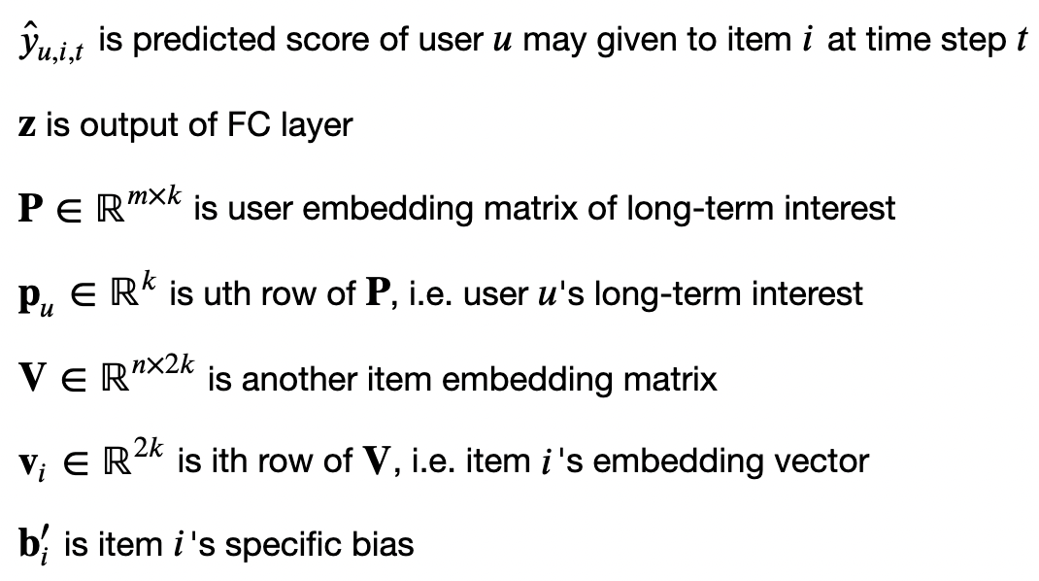
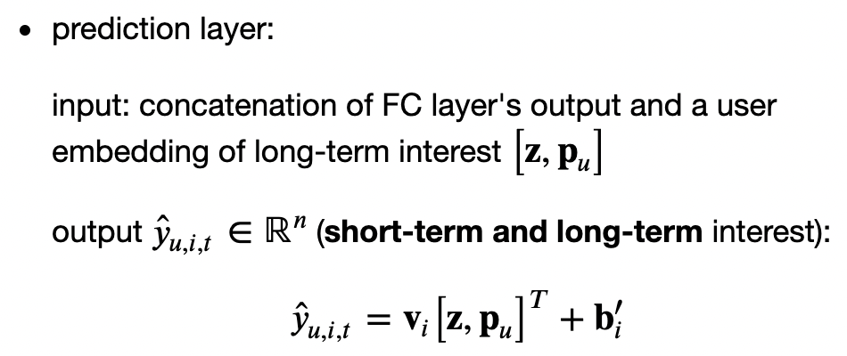
Caser: Notations

Slide 33
Content
Overview
Types of Rec Systems
Rec Tasks
Feedback
Pairwise Ranking Loss
Models
Matrix Factorization (MF)
AutoRec
NeuMF
Caser
Factorization Machine (FM)
DeepFM
Notebook
Dataset
Evaluation
Summary
Notes:
Finally, we comes to feature-rich rec systems: FM and deepFM
interaction data
are most basic indication of users’ interest
but they are very sparse and noisy
side info
like item features, user profiles and interaction context
can give model content or context awareness

Slide 34



Factorization Machine (FM)
2010
A feature-rich rec system
interaction + side info
A general framework for many tasks
Regression
Classification
Ranking
A generalization of linear regression model and matrix factorization model with extra strengths:
Notes:
some feature interactions can be easily understood, so experts can design them
but most feature interactions are hidden in data
so modeling feature interactions automatically reduce efforts in feature engineering
FM is a general framework for many tasks, such as regression, classification and ranking
it’s a generalization of linear regression and matrix factorization
can generalize to higher order >2,
but,numerical instability may weaken the generalization
and when using a good optimization algorithm such as SGD and Adam,
it’s efficient for high dimensional sparse inputs
can reduce time complexity from quadratic to linear
where 𝑘 is number of latent factors, 𝑑 is number of features

Slide 35


2-way FM: factorization machine of degree 2
For one sample, 2-way FM is defined as:
Linear model
Matrix factorization model
Notes:
2-way FM (factorization machine of degree 2) for one sample is defined as:
a global bias plus a linear model term plus a matrix factorization model term
𝐱 are features of a sample, 𝑥𝑖,𝑥𝑗 is ith feature, jth feature, respectively
dot product vi, vj models interaction between 2 features 𝑖,𝑗
if feature 𝑖 represents an item and feature 𝑗 represents a user, then the dot product is exactly interaction between item and user embeddings

Slide 36

2-way FM: Notations

Slide 37
Content
Overview
Types of Rec Systems
Rec Tasks
Feedback
Pairwise Ranking Loss
Models
Matrix Factorization (MF)
AutoRec
NeuMF
Caser
Factorization Machine (FM)
DeepFM
Notebook
Dataset
Evaluation
Summary
Notes:
our last model is DeepFM
dis of FM model: model feature interactions
in a linear way, e.g., bilinear
and in a low order way, often 2
DeepFM integrates deep neural net to FM
to model non-linear and high order feature interactions

Slide 38

DeepFM: Deep Factorization Machine
2017
Feature-rich rec system
Integrate deep neural net to FM
model non-linear and high order feature interactions
Model architecture: 1 FM block + 1 MLP block in parallel
FM: models low-order feature interactions
MLP: models high-order feature interactions and nonlinearities
Notes:
model architecture is a parallel FM block and a MLP block
FM models low-order feature interactions
while MLP models high-order and nonlinearities

Slide 39












DeepFM: Model Architecture
Notes:
2 blocks have same inputs/embeddings
their outputs are summed up as final prediction
FM block: is same as 2-way FM
for MLP block
input is concatenation of dense embedding e of all features
feature embeddings are generated by sparse categorical feature input

Slide 40
Content
Overview
Types of Rec Systems
Rec Tasks
Feedback
Pairwise Ranking Loss
Models
Matrix Factorization (MF)
AutoRec
NeuMF
Caser
Factorization Machine (FM)
DeepFM
Notebook
Dataset
Evaluation
Summary
Notes:
Before we go to Notebooks, I want to introduce the 2 datasets used in the Notebooks

Slide 41




MovieLens Dataset
MovieLens 100K (1999)
Models: MF, AutoRec, NeuMF, Caser
Run by GroupLens, 1997
A non-commercial web-based movie rec system
Used for research e.g. personalized rec and social psychology
Dataset used in Notebook: MovieLens 100K
100,000 ratings (1-5 ⭐️)
From 943 users on 1682 movies
Each user rated ≥ 20 movies
Demographic info: age, gender, genres for users/items
Notes:
the dataset used for training Models: MF, AutoRec, NeuMF, Caser is MovieLens 100K
collected by MovieLens, a web-based movie rec system Run by GroupLens
the dataset has 100 k ratings, ranged from 1 to 5 stars
collected from 943 users on 1682 movies
each user rated more than 20 movies
it also has some demographic info: age, gender, genres for users and items
the sparsity of interaction matrix is 0.93
so it’s very sparse

Slide 42

Online advertising dataset
Models: FM, DeepFM
Training set: 15k samples
Test set: 3k samples
Label: 1 if an ad was clicked, 0 if not
34 features: all categorical
e.g. Ad id, site, App id, device id, time, user profiles
Notes:
the second dataset in the notebook is an online advertising dataset
used for click-through rate prediction
and feature-rich rec system, FM and DeepFM
it has 15k training data and 3k test data
Label is 1 if an ad was clicked, 0 if not
34 categorical features, such as ad id, site, app id, device id, time and user profiles
here is first sample in the training set
each value represents one-hot index of corresponding entry
the last element is label

Slide 43
Content
Overview
Types of Rec Systems
Rec Tasks
Feedback
Pairwise Ranking Loss
Models
Matrix Factorization (MF)
AutoRec
NeuMF
Caser
Factorization Machine (FM)
DeepFM
Notebook
Dataset
Evaluation
Summary

Slide 44



Evaluations: MF
Embedding size (num_factors)
5 | 30 | 100
Notes:
we can change hyperparameters of these models
for MF, the Notebook uses 30 as dimensions of latent factor
we can change that
when dimensions are 5, the model may have risk of underfitting
when dimensions are 100, the model may have risk of overfitting

Slide 45



Evaluations: AutoRec
Hidden layer dimension (num_hidden)
50 | 500 | 5000
Notes:
for AutoRec, the Notebook uses 500 as dimensions of hidden layer
we can change that
when dimensions are 50, the model may have risk of underfitting
when dimensions are 5000, the model may have risk of overfitting

Slide 46



Evaluations: NeuMF
nums_hiddens=[10, 10, 10], BPR loss
Embedding size (num_factors)
2 | 10 | 100
Notes:
for NeuMF, the Notebook uses latent factor dim 10, a 3-layer MLP with constant hidden size 10 nums_hiddens=[10, 10, 10]
first we use BPR loss as loss function, preserve the MLP structure, change latent factor dim
when dimensions are 2 or 100, the metrics don’t change

Slide 47


Evaluations: NeuMF
Embedding size = 10
MLP structure(nums_hiddens)
[20, 10] | [10, 10, 10] | [40, 30, 20, 10]
Notes:
then we also use BPR loss as loss function, preserve embedding size as 10, change architecture of MLP
when structure is [20, 10] or [40, 30, 20, 10], metrics are similar

Slide 48

Evaluations: NeuMF
Embedding size = 10, nums_hiddens=[10, 10, 10]
Loss function
BPR Loss | Hinge Loss
Notes:
finally, we use Hinge loss as loss function, preserve embedding size as 10, and architecture of MLP [10, 10, 10]
the metrics are similar

Slide 49



Evaluations: Caser
Historical interactions length (L)
5 | 10 | 15
Notes:
for Caser, the Notebook considers 5 previous items
we can see suitable longer historical interactions bring higher accuracy

Slide 50



Evaluations: Factorization machine (FM)
Embedding size
5 | 20 | 100
Notes:
for FM, the Notebook uses 20 as embedding size
we can change that
when embedding size is 5, the test accuracy increase a little
when embedding size is 100, the test accuracy increase a lot

Slide 51



Evaluations: DeepFM
Embedding size = 10
Structure of MLP block (mlp_dims)
[20, 10] | [30, 20, 10] | [40, 30, 20, 10]
Notes:
for DeepFM, the Notebook set MLP block to be a 3-layered dense net with a pyramid structure: 30-20-10 and embedding size 10
when we preserve the embedding size, and change number of layers and number of neurons of each layer
when structure is 20-10, the test accuracy decrease, the model may have risk of underfitting
when structure is 40-30-20-10, the test accuracy also decrease, the model may have risk of overfitting

Slide 52






Evaluations
Rating Prediction | Personalized ranking | Click-through rate prediction
MF | NeuMF | FM
AutoRec | Caser | DeepFM
Notes:
the table can compare performance of different models for 3 kinds of rec tasks
AutoRec outperforms MF for rating prediction task coz it captures nonlinearity
Caser beats NeuMF for personalized ranking task coz it incorporates short-term interest
DeepFM converges faster and performs better than FM coz it models high-order feature interactions and nonlinearity

Slide 53
Content
Overview
Types of Rec Systems
Rec Tasks
Feedback
Pairwise Ranking Loss
Models
Matrix Factorization (MF)
AutoRec
NeuMF
Caser
Factorization Machine (FM)
DeepFM
Notebook
Dataset
Evaluation
Summary

Slide 54
Summary
Rec Systems | Rec Systems | CF-based, context-based, content-based
Rec Tasks | Rec Tasks | Rating prediction, Personalized ranking, Sequence-aware rec, Click-through rate prediction
Feedback | Feedback | Explicit, implicit
Ranking Loss | Ranking Loss | Pointwise, pairwise, listwise
Rating Prediction | MF AutoRec | Captures low-rank structure of user-item interaction
 | AutoRec | Frames MF with autoencoder to capture nonlinearity
Personalized ranking | NeuMF | Combines MF and MLP to capture nonlinearity
Sequence-aware rec | Caser | Uses CNN to capture user’s short-term and long-term interests
Click-through rate prediction | FM DeepFM | Combines LR and MF to capture 2-way feature interactions
 | DeepFM | Combines FM and MLP to capture high-order feature interactions and nonlinearity
Notes:
to recap previous contents
we have Collabrative filtering-based, context-based and content-based rec systems
rec tasks can be Rating prediction, Personalized ranking, Sequence-aware rec, Click-through rate prediction
feedbacks can be explicit or implicit
there are 3 types of ranking loss: pointwise, pairwise and listwise

